Slide 1
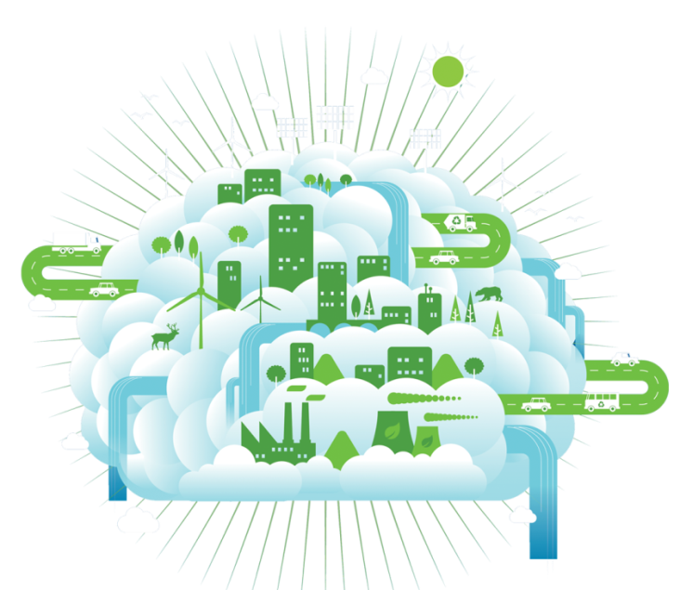
Outcomes of Paris Agreement and the Way Forward
Dr. Pradeep Monga
Director of Energy
UNIDO
22 March 2016

Slide 2
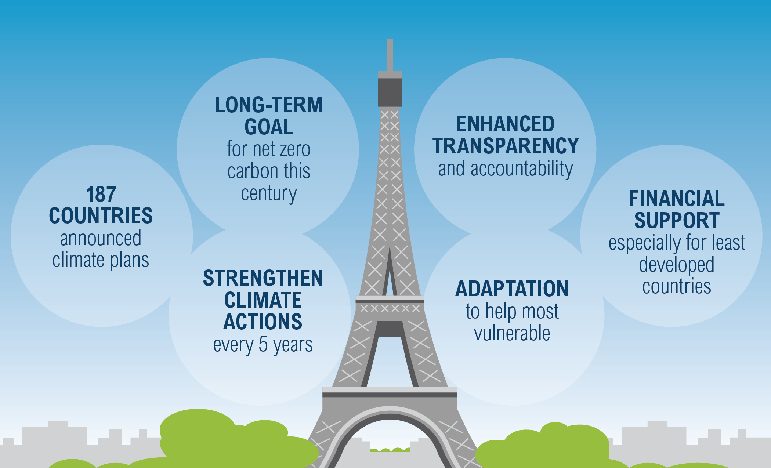
Paris Climate Agreement
Source: UNFCCC/WRI

Slide 3
Industry, Energy and Climate Change
Global Primary Energy Demand by 2030:
50% increase expected
87% from non-OECD countries (industry biggest user)
Industry accounts
for 1/3
of global energy use:
40% of electricity
77% of coal & derivatives
37% of natural gas
Single largest source
of GHG emissions:
32% of global emissions
Source: IEA, Technology Transitions for Industry, 2009

Slide 4
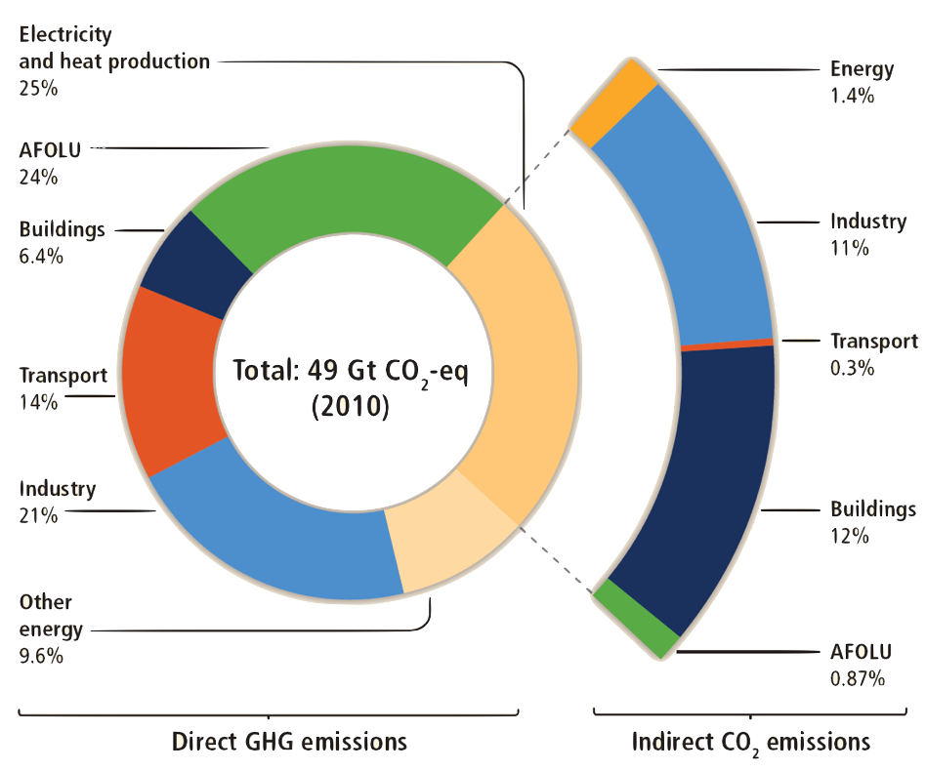
Greenhouse Gas Emissions by Economic Sector
Source: IPCC AR5
Notes:
Figure 1.7 | Total anthropogenic greenhouse gas (GHG) emissions (gigatonne of CO2- equivalent per year, GtCO2-eq/yr) from economic sectors in 2010. The circle shows the shares of direct GHG emissions (in % of total anthropogenic GHG emissions) from five economic sectors in 2010. The pull-out shows how shares of indirect CO2 emissions (in % of total anthropogenic GHG emissions) from electricity and heat production are attributed to sectors of final energy use. ‘Other energy’ refers to all GHG emission sources in the energy sector as defined in WGIII Annex II, other than electricity and heat production {WGIII Annex II.9.1}. The emission data on agriculture, forestry and other land use (AFOLU) includes land-based CO2 emissions from forest fires, peat fires and peat decay that approximate to net CO2 flux from the sub-sectors of forestry and other land use (FOLU) as described in Chapter 11 of the WGIII report. Emissions are converted into CO2-equivalents based on 100-year Global Warming Potential (GWP100), taken from the IPCC Second Assessment Report (SAR). Sector definitions are provided in WGIII Annex II.9. {WGIII Figure SPM.2}

Slide 5
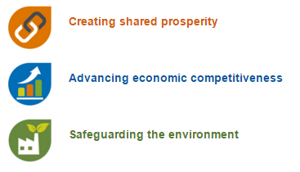
UNIDO’s Mandate: Inclusive & Sustainable Industrial Development (ISID)
Thematic Areas:
Achieving equitable & sustainable social, economic and environmental growth while mainstreaming women and youth.

Slide 6


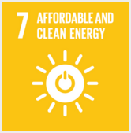
Industry, SE4ALL and SDGs
Jobs Creation
Business Models
Women’s Empowerment
Nexus Co-benefits
Promoting innovation
Sustainable Energy and Climate Agreement
SDG 9
ISID
SDG 7
Sustainable Energy
SDG 13
Climate Action

Slide 7
Sustainable Industrialization
produce more with less
economic progress with less environmental impact
resource decoupling
human well-being
economic activity (GDP)
resource use
environmental impact
impact decoupling
Notes:
Sustainable industrialization wants to decouple resource use from economic activity and human well-being.

Slide 8

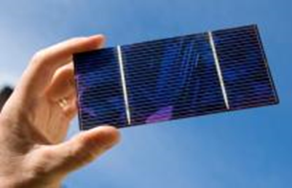
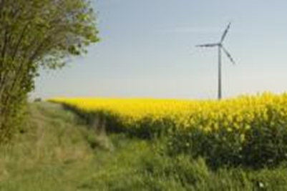

Promoting sustainable energy solutions for productive capacities, industrial competitiveness and job creation
Industrial Energy Efficiency
Renewable Energy for Productive Uses
Low-Carbon Low Emission Technologies
Climate Policy, Partnership and Global Forums
Notes:
Energy Management Standards Programme—to integrate energy efficiency and systems optimization. UNIDO supported the development of ISO50001 on Energy Management Standards, and its pilot application in the industrial sector in 14 countries. Other services include advocacy, training, institution-building, and demonstration projects
GEF-Strategic Programme for West Africa (SPWA) - Energy Component. Promotes access to modern energy services, increases use of renewables and improves energy efficiency; offers policy advice; promotes regional integration of energy markets

Slide 9
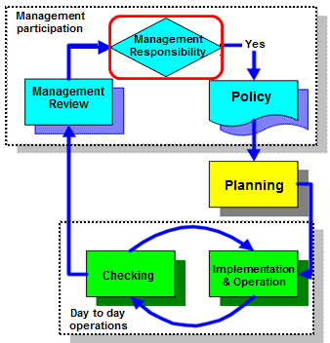
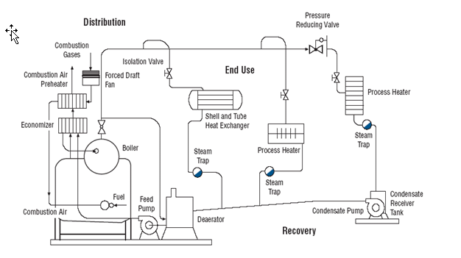
UNIDO Industrial Energy Efficiency Programme
Energy Management Systems
Energy System Optimization
Distribution
End Use
Recovery
Generation
Auxiliary energy systems account for over 50% of final manufacturing energy consumption
System optimization average efficiency gains range between 15-30% against
4-5 % of individual components
EE INTEGRATED
Energy Savings & Investments
Notes:
9

Slide 10
UNIDO Renewable Energy Programme
New business paradigm
Distributed energy
Industrial Applications
Business Models
Mini-grids
Create business development opportunities through increasing access to energy through mini-grids;
Mainstream the use of renewable energy in industry (SMEs);
Support innovative business models to promote renewable energy in the business sector
Productive uses
Renewable energy enterprises
Green industry (local manufacturing)

Slide 11
Sustainable Industrialization and Climate Change
KEY AREAS OF UNIDO’s INTERVENTIONS
LOW CARBON TECHNOLOGY TRANSFER
CLEAN TECHNOLOGY INNOVATION
NEW FINANCING INSTRUMENTS: PRIVATE SECTOR
REGIONAL COOPERATION
KNOWLEDGE MANAGEMENT AND CAPACITY BUILDING

Slide 12
UNIDO: Tackling climate change
Montreal Protocol:
Each year 5-6 times of 1st phase of Kyoto Protocol in CO2e avoided
Until 2010: 70,287 tonnes Ozone Depleting Potential
UNIDO: 1200 projects, globally 27% share, 100 countries
Sustainable Energy:
SE4ALL objectives in line with 2 degree Celsius target
By 2015: 200 million with electricity and 400 million clean cooking
80 countries opted-in and 118 with RE policy targets
UNIDO: ~120 projects, 50+ countries
Mitigation and Adaptation
New: climate resilient industries along energy-water-food nexus
UNIDO: several Large Maritime Ecosystems (LME) rehabilitation

Slide 13



Climate Technology Centre and Network (CTCN)
Operative arm of the UNFCCC Technology Mechanism
Working for National Designated Entities
CTCN is hosted by UNEP and UNIDO
Affiliated networks
11 independent, regional and global consortium partner organizations with expertise in climate change technologies
International network of 100+ academic, multilateral, NGO and private sector institutions
Strategic Partners

Slide 14

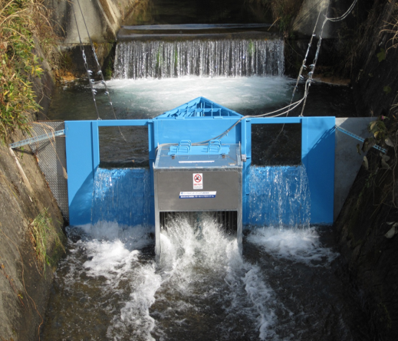
Low Carbon Low Emission Clean Energy Technology Transfer (LCET) Programme
Promoting dissemination of low carbon technologies in developing countries to increase access to renewable energy for productive uses and job creation in rural areas.
Countries targeted: Ethiopia, Kenya
Pilots:
Demonstrating innovative advanced Micro Hydropower and Solar Energy Technologies in the initial phase

Slide 15




Innovation Ecosystem for SMEs Global Cleantech Innovation Programme (GCIP)
Policy and Regulations
A Cleantech Innovation Index for SMEs
Mentoring and Training
Business Clinics
Investor Connect
Fostering
an Innovative
Cleantech Ecosystem
Linking Innovative Enterprises to Private Sector Financing and CSR Initiatives
Building the National Institutional Capacity

Slide 16
Private Financing Advisory Network (PFAN)
Multilateral public-private partnership that nurtures clean energy projects by bridging the gap between investors and clean energy entrepreneurs and project developers
Advice and Guidance
financial structuring
sourcing of equity and debt
business growth
strategy, preparation and presentation of business plans
Matching Projects with Investors
selected projects introduced to investors financing forums
direct introduction to network investors and other potential investment sources
Funding partners include:
Climate Technology Initiative (CTI); multilateral initiative (Australia, Austria, Canada, Germany, Japan, Norway, the Republic of Korea, Sweden, the United Kingdom and the United States)
United States Agency for International Development (USAID)
Energy and Climate Partnership of the Americas (ECPA)
International Development Research Centre (IDRC) / Canada
International Center for Environmental Technology Transfer (ICETT ) / Japan
Pledges for forthcoming funding from Australia, Sweden, USA, Japan and Green Climate Fund

Slide 17

Flagship Programme on Sustainable Cities
More than half of the global population today live in cities. By 2050, this is expected to increase to two-thirds.
Sustainable Cities are vital to ensure people, the urban infrastructure and the local ecosystem do not suffer due to unsustainable urban growth.
GEF launched the Sustainable Cities Integrated Approach Pilot (SC-IAP) to help cities address environmental degradation caused by rapid urbanization. UNIDO as the implementing agency has projects in Senegal, Malaysia, Cote d’Ivoire, China and India.

Slide 18
UNIDO and Sustainable Energy for All (SE4ALL)
Global Hub for Industrial Energy Efficiency
Regional Approaches and Country Level Action Plans – Focus on IEE and RE Technologies
System Approach on Nexus Issues (Energy-Water-Food-Health)
Technology Transfer, Scaling up Investments and Capacity Building
Strategic Partnership

Slide 19
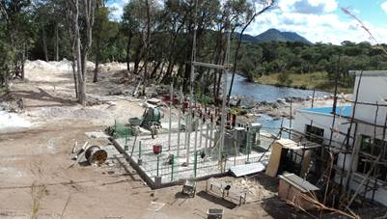
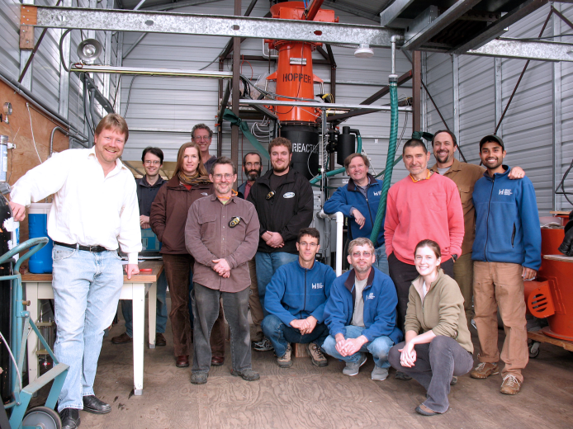
South-South Cooperation
Technology Transfer and Knowledge Management
India (UCSSIC)-Benin-Nigeria: Biomass gasification technology
India(UCSSIC)- Bangladesh: Solar Micro-utility enterprises for promoting rural energy and productive uses
South Korea-Ghana: Supporting green industrial development through biogas technology and business for sustainable growth
China (International Centre for Small hydro Power and International Solar Energy Center): Renewable Energy based electricity Generation for Isolated Mini Grids in Zambia, Sierra Leone, Nigeria, LAC region
Brazil – Africa (International Biogas Centre, Itaipu): SADC, ECOWAS and EAC

Slide 20
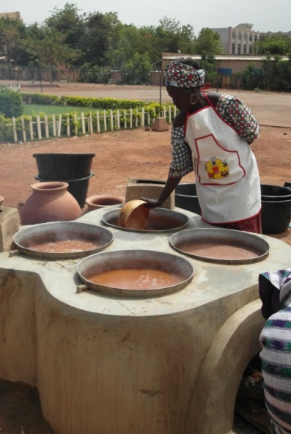
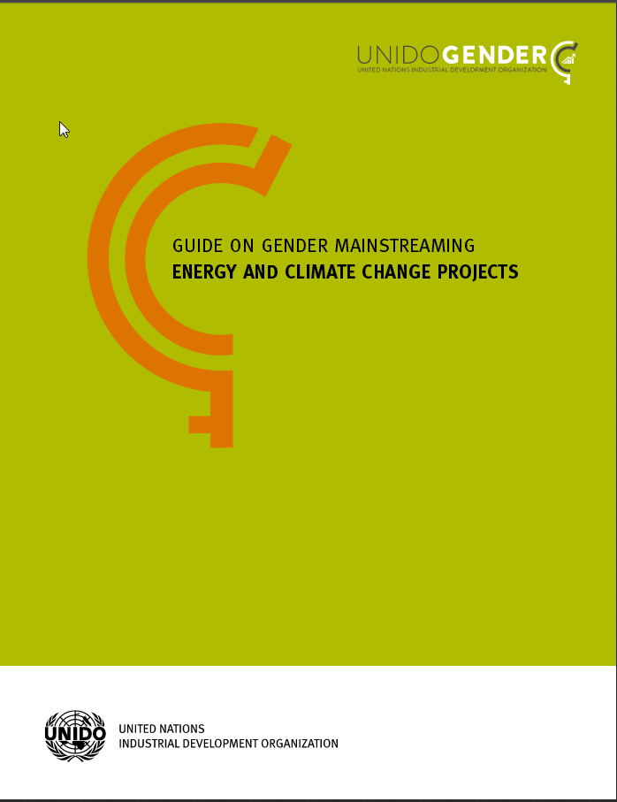

Women’s Empowerment and Gender Mainstreaming
Best practice project
Empowering women beer brewers using energy efficient stoves in Burkina Faso
Publications 1- Sustainable Energy for all: the Gender Dimensions (UNIDO-UN Women joint publication)
2- Energy-Gender Mainstreaming Guide
(UNIDO publication)
Technical assistance to 1,600 women entrepreneurs
Increased profits achieved by a 40-50% reduction in the amount of firewood consumed
Foster women’s access to financial institutions/ business and knowledge gateways
Improvements to the health and environmental conditions

Slide 21
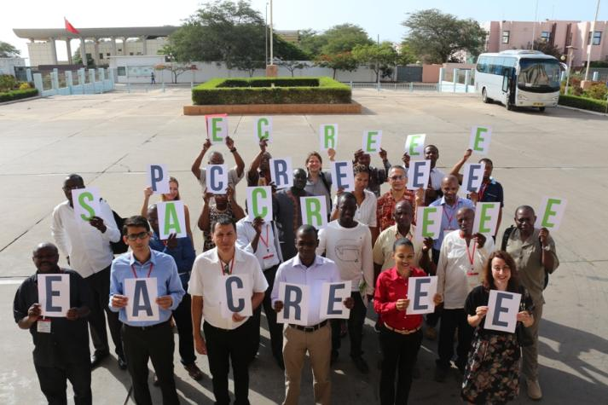









Global Network of Regional Sustainable Energy Centres Hubs for SE4ALL and Climate Action

Slide 22
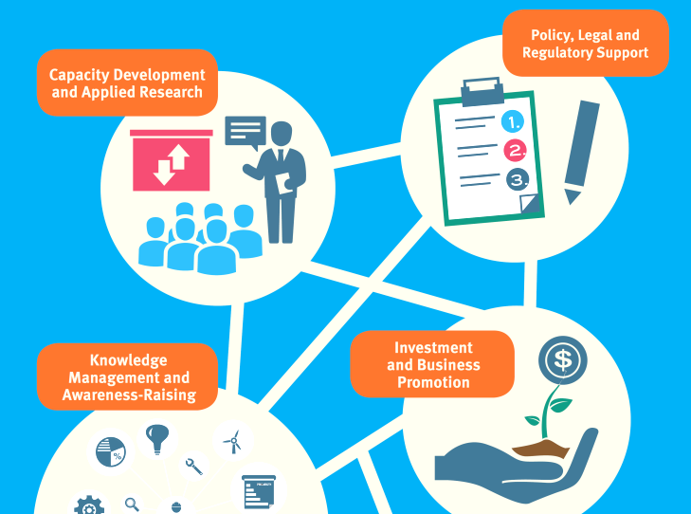
Accelerate and complement national efforts through regional interventions

Slide 23
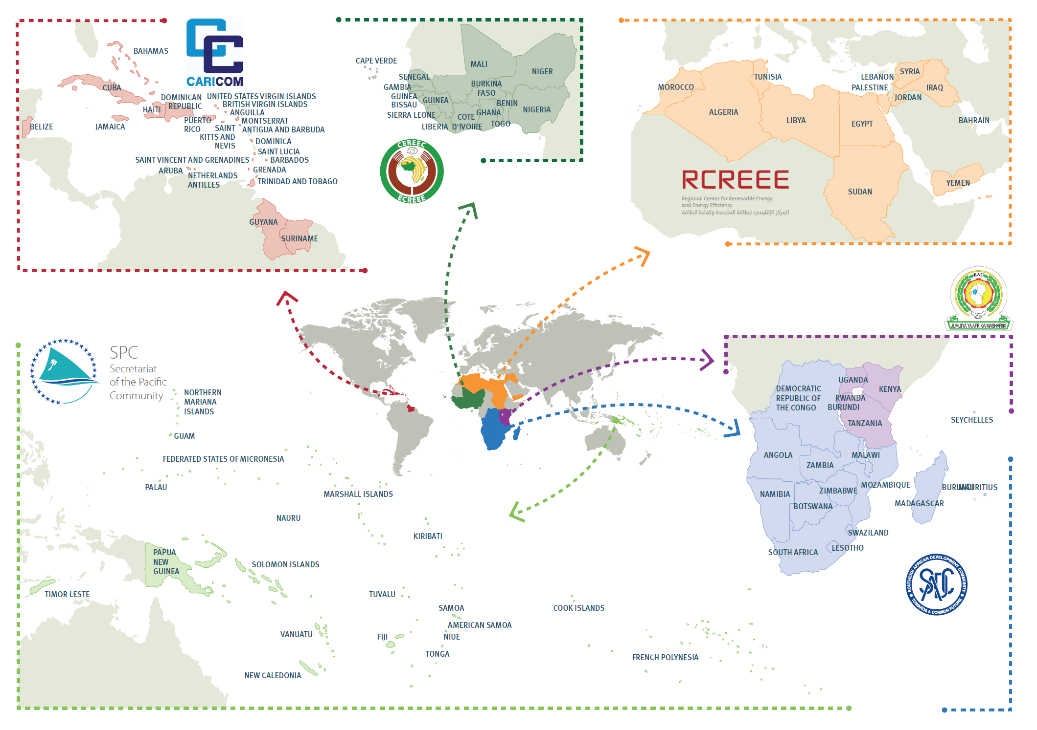


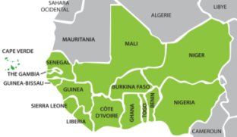

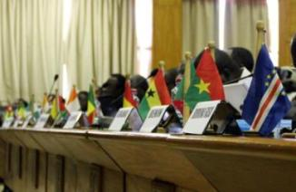
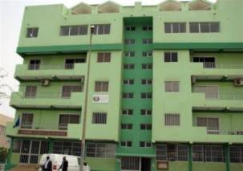
Southern African Centre for Renewable Energy and Energy Efficiency (SACREEE) – Namibia
East African Centre for Renewable Energy and Energy Efficiency (EACREEE) - Uganda
ECOWAS Centre for Renewable Energy and Energy Efficiency (ECREEE) – Cape Verde
Notes:
ECREEE
Specialized Agency of the Economic Community of West African States (ECOWAS) to promote RE&EE
Covering 15 Member States and 300 million energy consumers
Established in 2010 with support of UNIDO, Austria and Spain
Secretariat in Praia, Cape Verde
Concrete GEF funded Projects
SACREEE
The Southern African Development Community (SADC) comprises 15 Member States and represents 280 million energy consumers.
At the 32nd SADC Ordinary Summit in Maputo, Mozambique, the Ministers of Energy directed the SADC Secretariat to create a regional sustainable energy centre.
A baseline report and a needs assessment on the technical and institutional design of the Centre were prepared.
The design of the Centre was validated by all Ministries of Energy during a consultative workshop held from 14 to 15 March 2013 in Kempton Park, South Africa, and at a validation workshop held from 18 to 19 July 2013, in Gaborone, Botswana
On 24 July 2015 the SADC Ministers responsible for Energy approved SACREEE and nominated Namibia as the host country of the Secretariat of the centre.
EACREEE
The East African Community (EAC) represents a growing population of 133 million energy consumers.
At the 7th and 8th meetings of the Sectoral Council on Energy, the governments directed the EAC Secretariat to move forward to establish a regional sustainable energy centre.
A RE&EE baseline report and a needs assessment on the technical and institutional design of the Centre were developed.
The EACREEE design was validated successfully during an inception workshop, held from 11 to 12 March 2013 in Arusha, Tanzania, and a final workshop, held from 6 to 7 May 2013 in Kampala, Uganda.
EACREEE was approved by the Ministers of Energy during the 9th Meeting of the EAC Sectoral Council on Energy, 21 April 2014 in Nairobi, Kenya.
In September 2015 the EAC Sectoral Council on Energy approved Kampala, Uganda, as the host country of EACREEE.

Slide 24
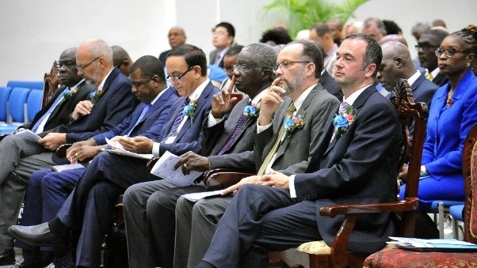
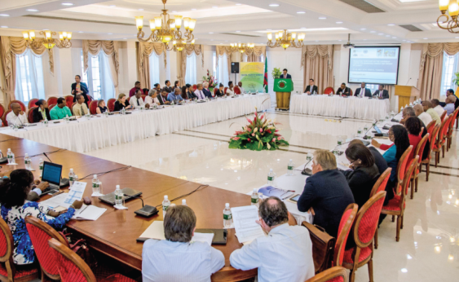


Caribbean Centre for Renewable Energy and Energy Efficiency (CCREEE)
Preparatory process with SIDS DOCK and CARICOM
CCREEE approved by the Ministerial COTEDs on Energy and Environment in Nov. 2014 and Feb. 2015
The 36th Regular Meeting of CARICOM Heads of Government, held at Bridgetown, Barbados, 2-4 July 2015, endorsed the creation of CCREEE and confirmed Barbados, as the host country.
Inauguration of the centre took place on 28 October 2015 in Barbados

Slide 25


Pacific Centre for Renewable Energy and Energy Efficiency (PCREEE)
Partnership with SPC and SIDS DOCK
Needs assessment and project document on the design of the centre finalized
In September 2015, SPC was confirmed as the host for PCREEE by the Pacific Ministers of Energy.
PCREEE to be hosted by the Kingdom of Tonga under the SPC framework
Planned inauguration in August 2016

Slide 26
ACP – UNIDO COOPERATION FOR CLIMATE ACTION
POTENTIAL AREAS of FUTURE COOPERATION:
Programmatic approaches for technology transfer and innovation (CTCN, Cleantech, SE4ALL, PFAN)
Regional cooperation (Regional Centres for Policy, Institutional and Markets Coherence)
Knowledge Management and Capacity Building (Regional Centres as Hubs for SE4ALL, Nexus Issues and Climate Action)
Public Private Partnerships (Financing, Jobs and Economic Development)

Slide 27
Thank you Dr. Pradeep Monga Director of Energy United Nations Industrial Development Organization p.monga@unido.org

